Slide 1
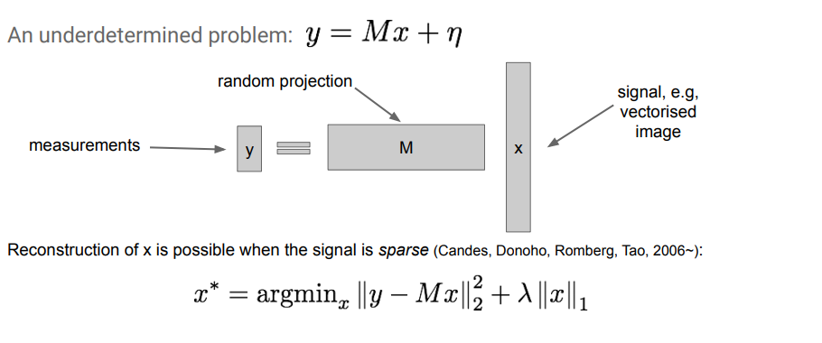
Compressed Sensing

Slide 2
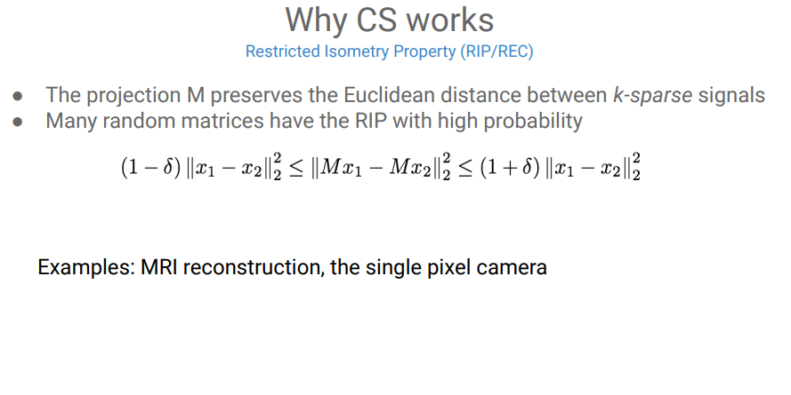
Compressed Sensing

Slide 3


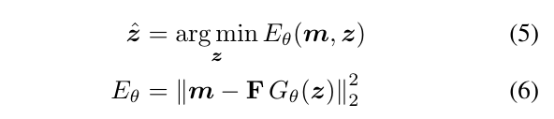
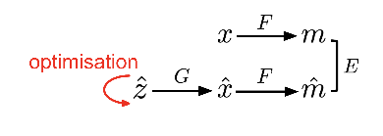
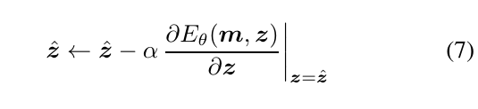
Compressed Sensing with Neural Network Generators
Requirement of sparsity
the requirement that x be sparse can be replaced by sparsity in a set of basis Φ (Fourier basis), However, they are restricted to domains known to be sparse in these bases and cannot adapt to data distributions.
NP-hard
. Relax the requirement, using structural constraint in place of sparsity
G() is pretrained model and not optimized for CS
G() is nonlinear
hundreds or thousands of gradient descent steps and
several re-starts from the initial step

Slide 4
Meta Learning
Definition
Meta-learning, also known as “learning to learn”, intends to design models that can learn new skills or adapt to new environments rapidly with a few training examples.
Example
People who know how to ride a bike are likely to discover the way to ride a motorcycle fast with little or even no demonstration.
A classifier trained on non-cat images can tell whether a given image contains a cat after seeing a handful of cat pictures.
Approach
learn an efficient distance metric (metric-based)
use (recurrent) network with external or internal memory (model-based)
optimize the model parameters explicitly for fast learning (optimization-based)

Slide 5
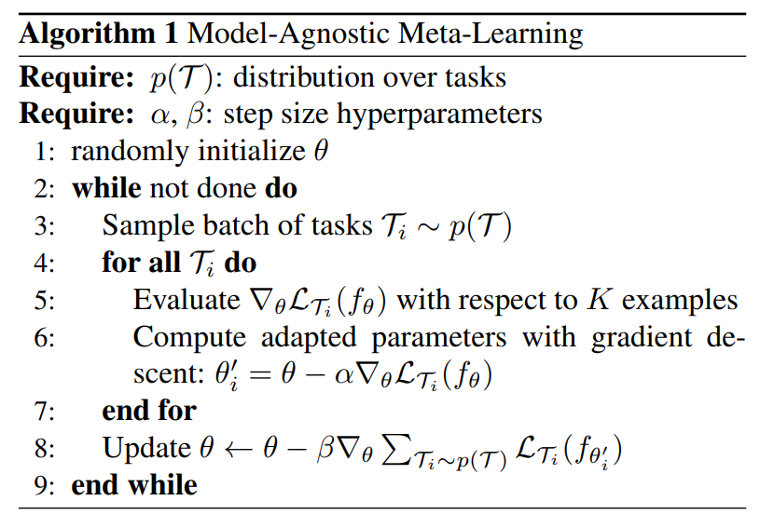
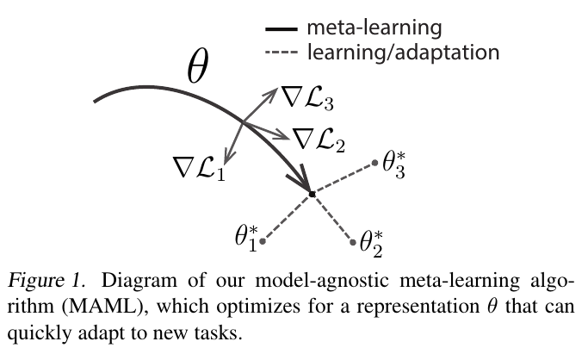

Optimization-based Meta-learning
A neural network might learn internal features that are broadly applicable to all tasks in p(T)
To achieve a good generalization across a variety of tasks, we would like to find the optimal θ∗, so that the task-specific fine-tuning is more efficient
SGD

Slide 6
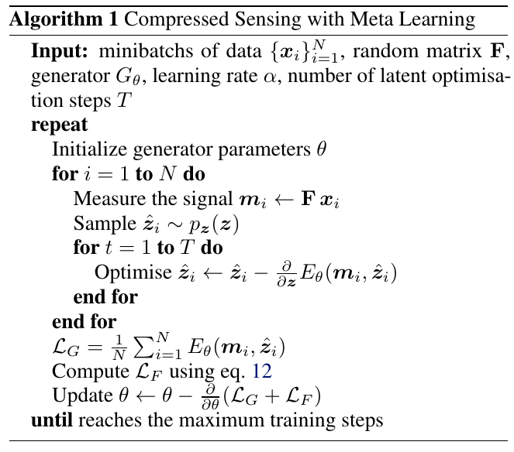





Modification based on Meta-learning

Slide 7
Modification based on Meta-learning

Slide 8
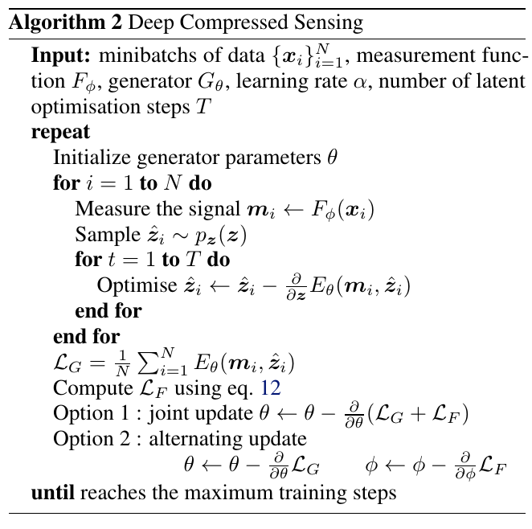


Modification based on Learned F

Slide 9

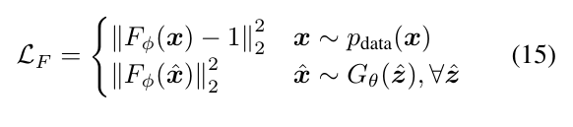
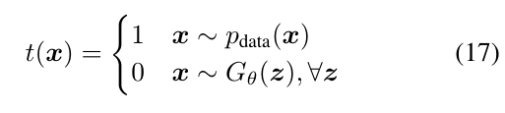
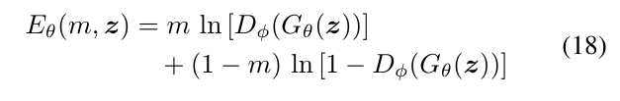
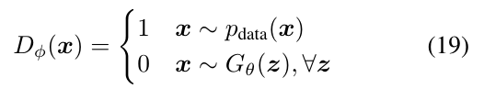
Similar to vanilla GAN
they are exactly equivalent when the latent optimization is disabled (T = 0, zero step) latent optimisation moves the representation to areas more likely to generate realistic images deemed by the discriminator.

Slide 10
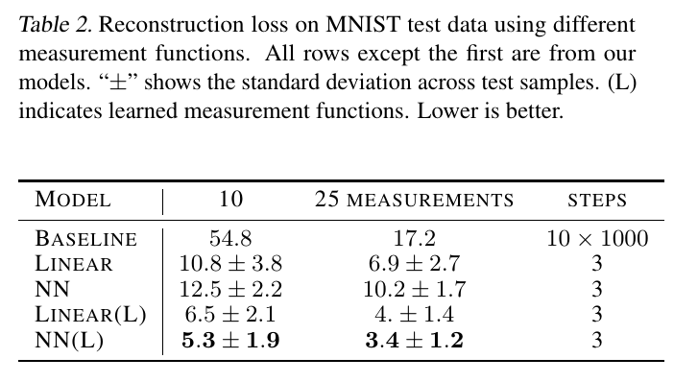
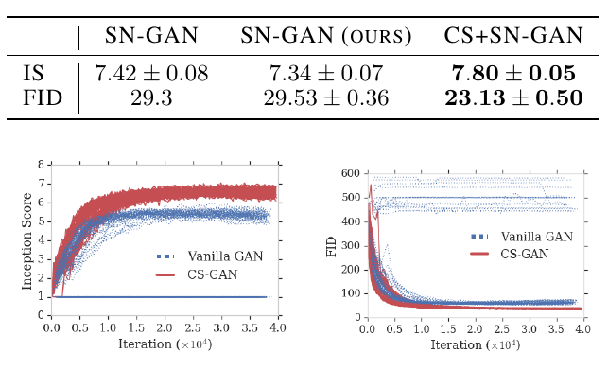
Results

Slide 11
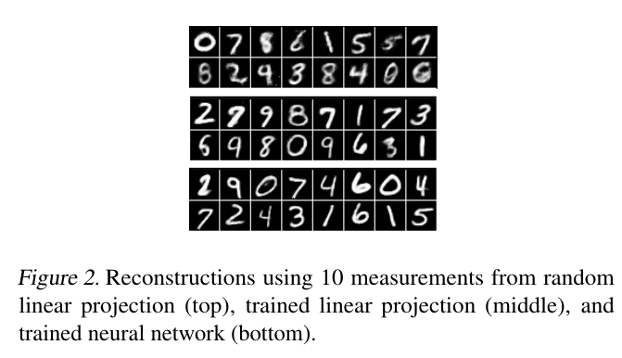
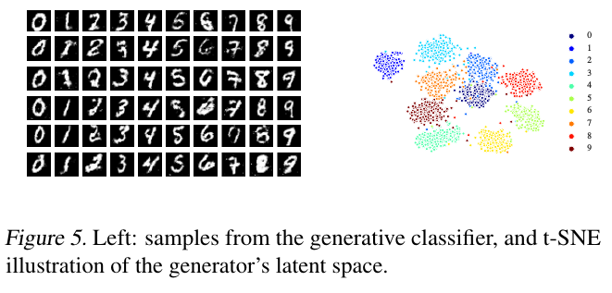
Results

Slide 12
Deep Compressed Sensing
1. Meta-learned reconstruction process leads to a more accurate and faster method
2. Develop a new GAN training algorithm based on latent optimization

